Slide 1

THE OLYMPICS:
A DATA ODYSSEY
PRESENTED BY
INNOVATION PIONEERS

Slide 2




TEAM
INNOVATION PIONEERS
Ayushi Tawari
Mutta Datta Sai
Vishnu Mohan
Niranjana J

Slide 3
Introduction
Overview
Nature of dataset
Objectives
Approach
Visualization & techniques
Insights
Challenges
Conclusion

Slide 4







INTRODUCTION
The Olympic Games are a global phenomenon, a celebration of athletic prowess that transcends borders and unites nations. This presentation dives into a comprehensive analysis of Olympic Games data spanning from the 1896 Summer Olympics in Athens to the 2016 Summer Olympics in Rio de Janeiro. Through this exploration, we've uncovered a wealth of insights, including trends in athlete participation, medal distribution patterns, and the evolving landscape of national dominance in the Olympics.

Slide 5
NATURE OF DATASET
Our analysis centers around a rich dataset encompassing information on athletes, their participation details, and their National Olympic Committee (NOC) affiliation. This comprehensive resource, spanning over 270,000 entries, offers insights into athlete performance across various categories from 1896 to 2016.

Slide 6





OBJECTIVES
1
Performance analysis
2
Country analysis
3
Trend analysis
4
Demography analysis
5
Physique analysis

Slide 7





Data Preprocessing
Descriptive analysis
Exploratory Data Analysis (EDA)
Correlation Analysis
Insight synthesis
APPROACH

Slide 8

VISUALIZATION
Pandas
Bar chart
Numpy
Pie chart
Matplotlib
Line chart
Seaborn
Choropleth
Plotly
Heatmap

Slide 9
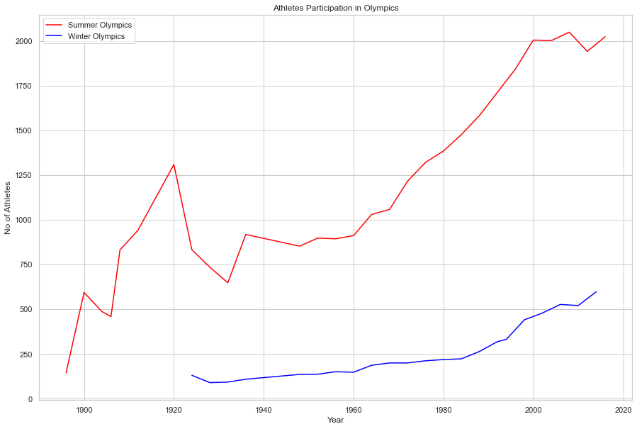
INSIGHTS
Popularity analysis
The inaugural Olympics in 1896, hosted in Greece, marked the beginning of the Summer Games tradition while the Winter Olympics emerged around 1924.

Slide 10
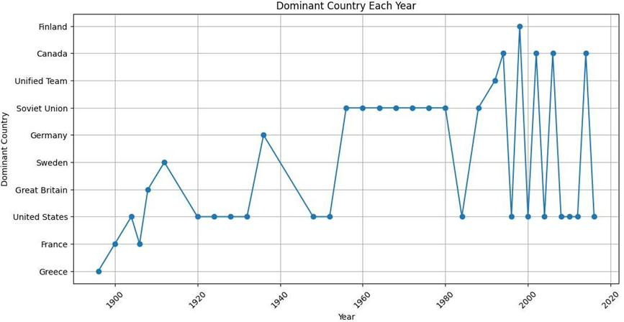
The United States has consistently secured the highest number of medals throughout Olympic history.
The Soviet Union gained prominence from the 1950s to the 1990s but saw a decline in performance after its collapse.

Slide 11
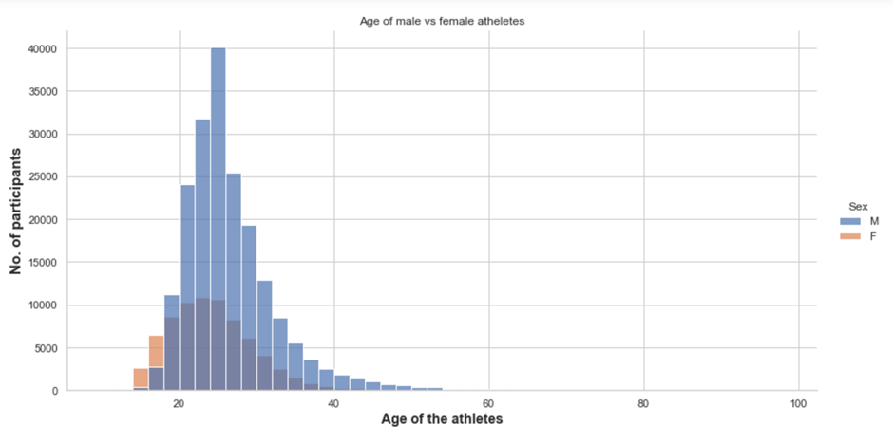

It was observed that the optimal age to win a gold, silver and bronze medal was in between 25-28.

Slide 12
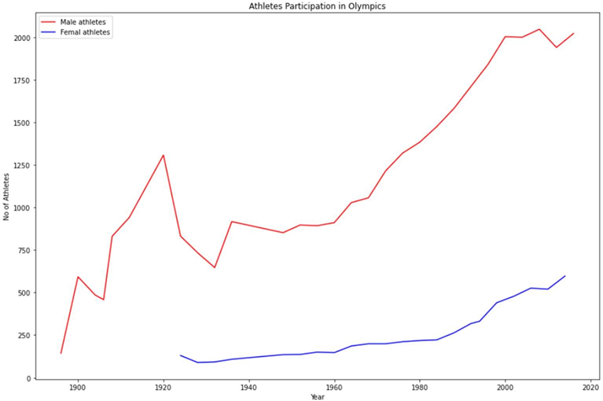
As for the athletes,there have been 74,522 female athletes and 196,594 male competitors that have competed in the Olympics thus far. The majority of the participants were from the US, France, and the UK.

Slide 13
Athletics has ruled supreme over all other sports since the 1896 Olympic Games in Athens.
The optimal age to win a gold, silver and bronze medal was in between 20 and 30.
Only 17.2% of the athletes win a medal.
Sports like gymnastics, boxing, cycling etc. also remains relevant
Throughout the annals of Olympic history, female participation has remained a minority

Slide 14
Temporal Scope: The analysis may focus on a specific range of years or Olympics editions due to data availability or relevance.
CHALLENGES
Data Quality: Delimitations may be imposed based on the quality and reliability of the dataset.High degree of missing values or inconsistencies that could compromise the validity of results.
Research Objectives: Delimitations are often defined by the specific research questions or objectives of the study. The analysis may focus on addressing specific research questions while omitting broader or tangential topics.

Slide 15

CITIUS, ALTIUS, FORTIUS, COMMUNITER
THANK YOU

